Slide 1

Wifi Duck
Sprint 4 Update
Sophia Evans & Tsani Rogers

Slide 2
Sprint 4 Goals
-Test duck on different devices (phone, ipad, etc)
-Start writing original scripts for final presentation.
-Have a simple demo of the project for sprint 4 presentations.
-Embed device into a charger to simulate a malicious port.

Slide 3
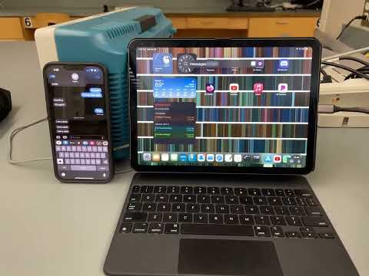
Sprint 4 Achievements
-Successfully used duck to send a text message from iPad
-Developed basic setup for embedding device into charging port using a usb-c hub
-set up scripts to autorun when device is plugged in
-used duck to locate a target file on mac and copy it to a separate usb flash drive

Slide 4
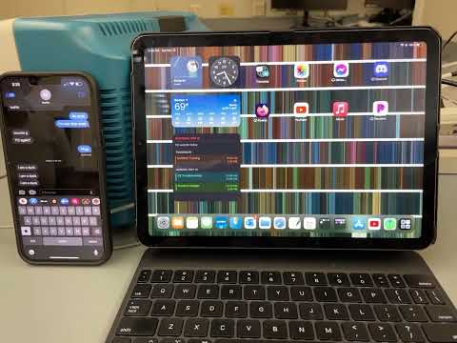
What Didn’t Work
-Sometimes getting internal errors where device has to be removed and plugged in again
-On iPad, autorun will sometimes ignore the specified script and instead open the top left widget/app on the home screen
-Macs often show a pop-up window when an unknown keyboard is connected (such as a duck)
-This is good for the general public, bad for our project

Slide 5
Next Sprint Goals
-conceal wifi duck inside charging brick
-Test on iphone and windows
-Continue working on exfiltrating information from target device
-integrated storage
-sending information over internet

Slide 6


